Slide 1
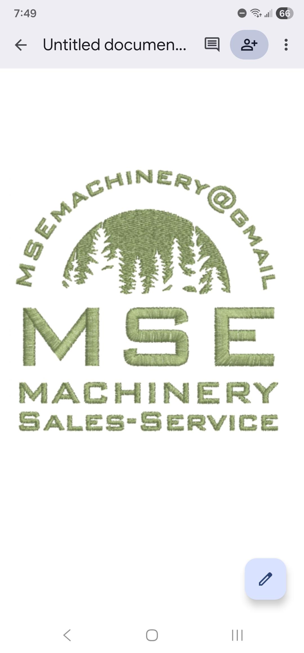



Boutique Farm Equipment DEALERSHIP, SHOWROOM & STORAGE PROPOSAL
Presented by Glen O’Brien, P.eng (Owner)
Simcoe Muskoka
The Perfect Match of Size and Power

Slide 2
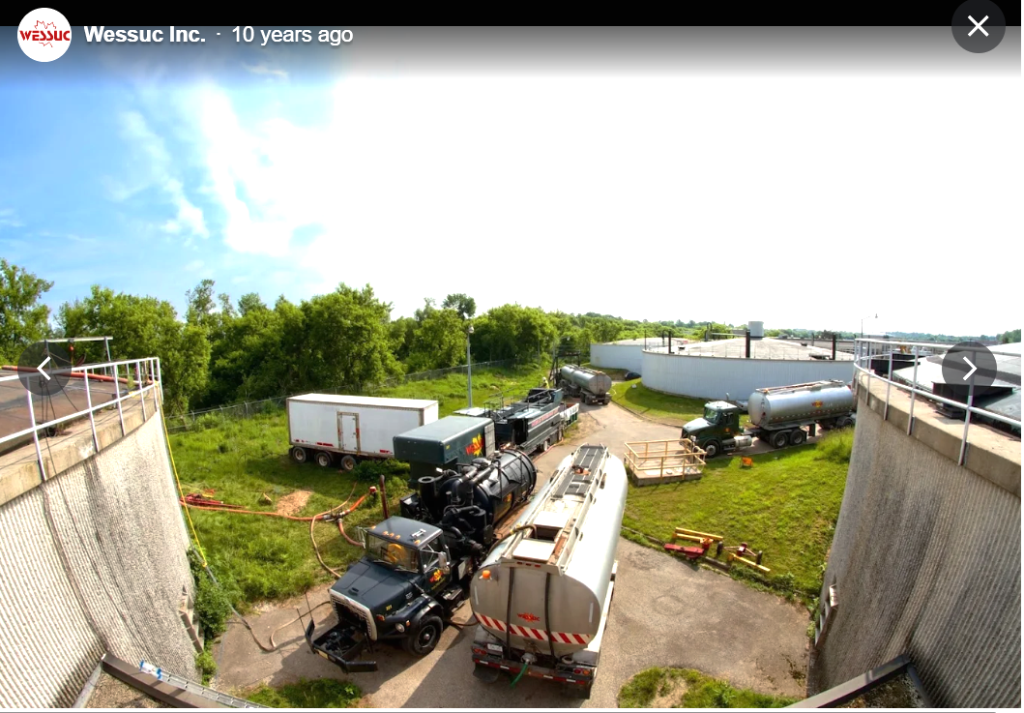
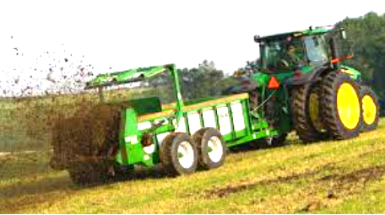

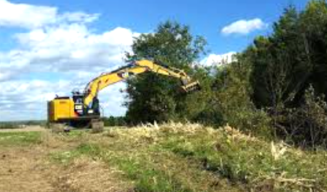
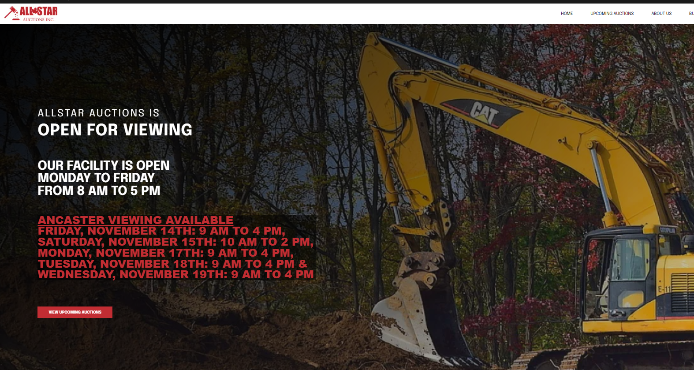
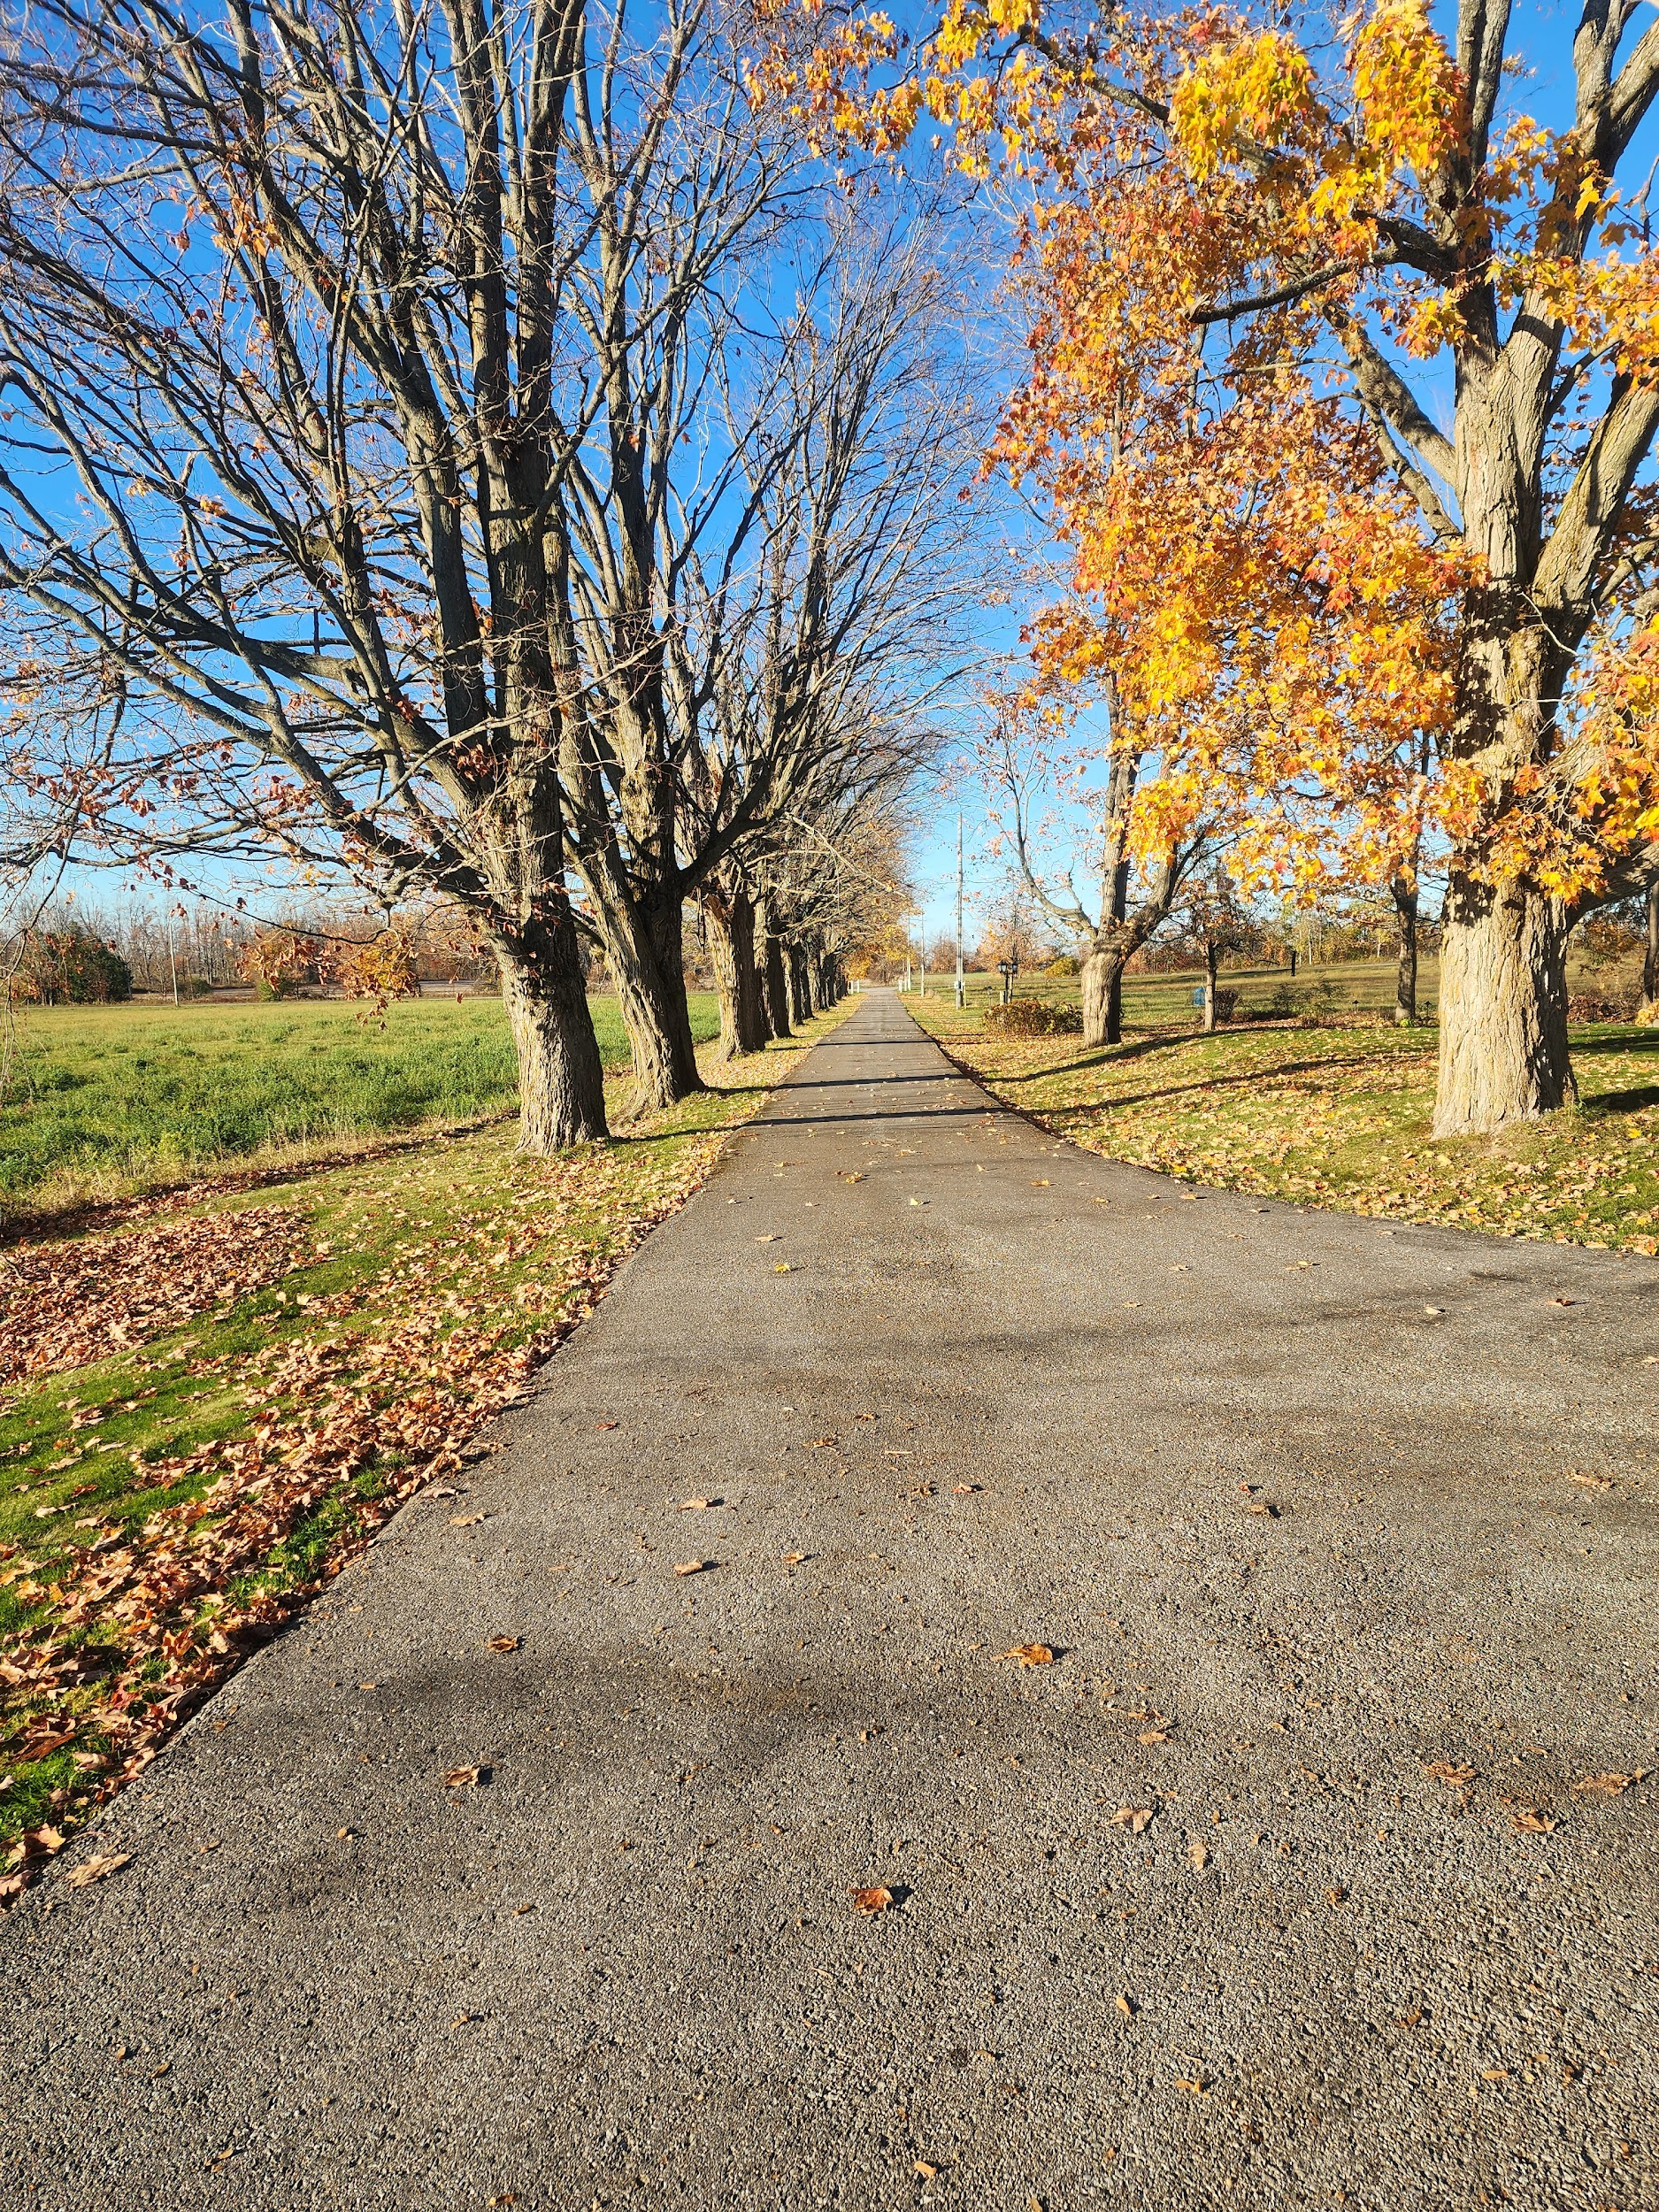
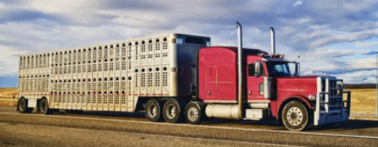
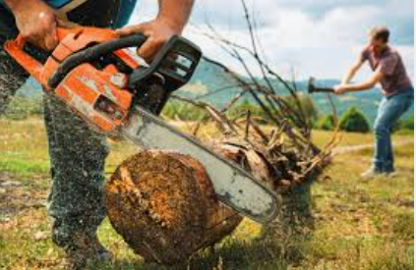
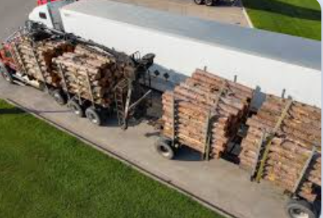
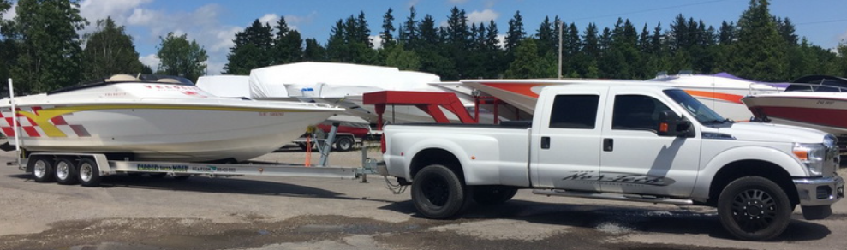
Existing Rural Character is an important selling feature of MSE Machinery
WELCOME to Ontario’s Lake Country
Simcoe Muskoka
A place with LOTS of PEOPLE doing LOTS of different THINGS using LOTS of EQUIPMENT

Slide 3

Why build a NEW small Farm Machine Dealership in SIMCOE-MUSKOKA?
HUGE DEMAND for small Tractors !
HUGE DEMAND for Attachments!
Simcoe Muskoka

Slide 4
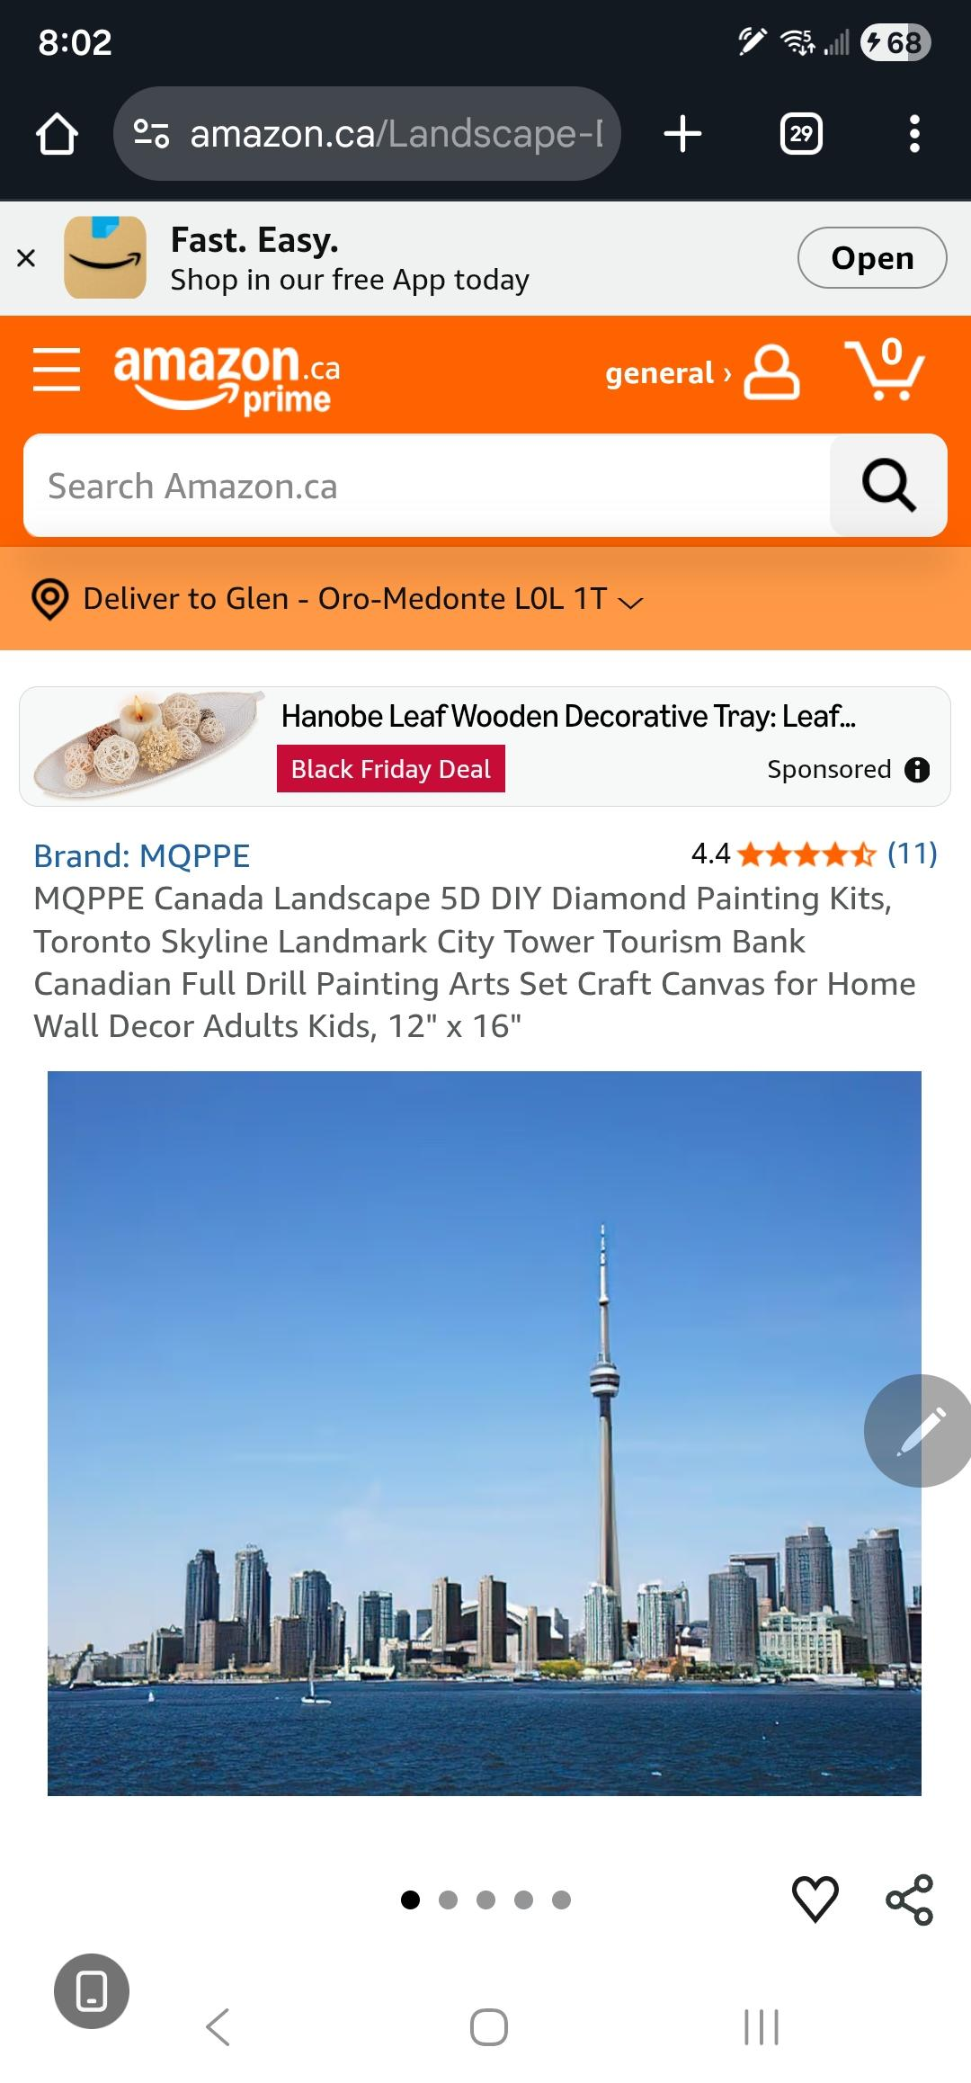
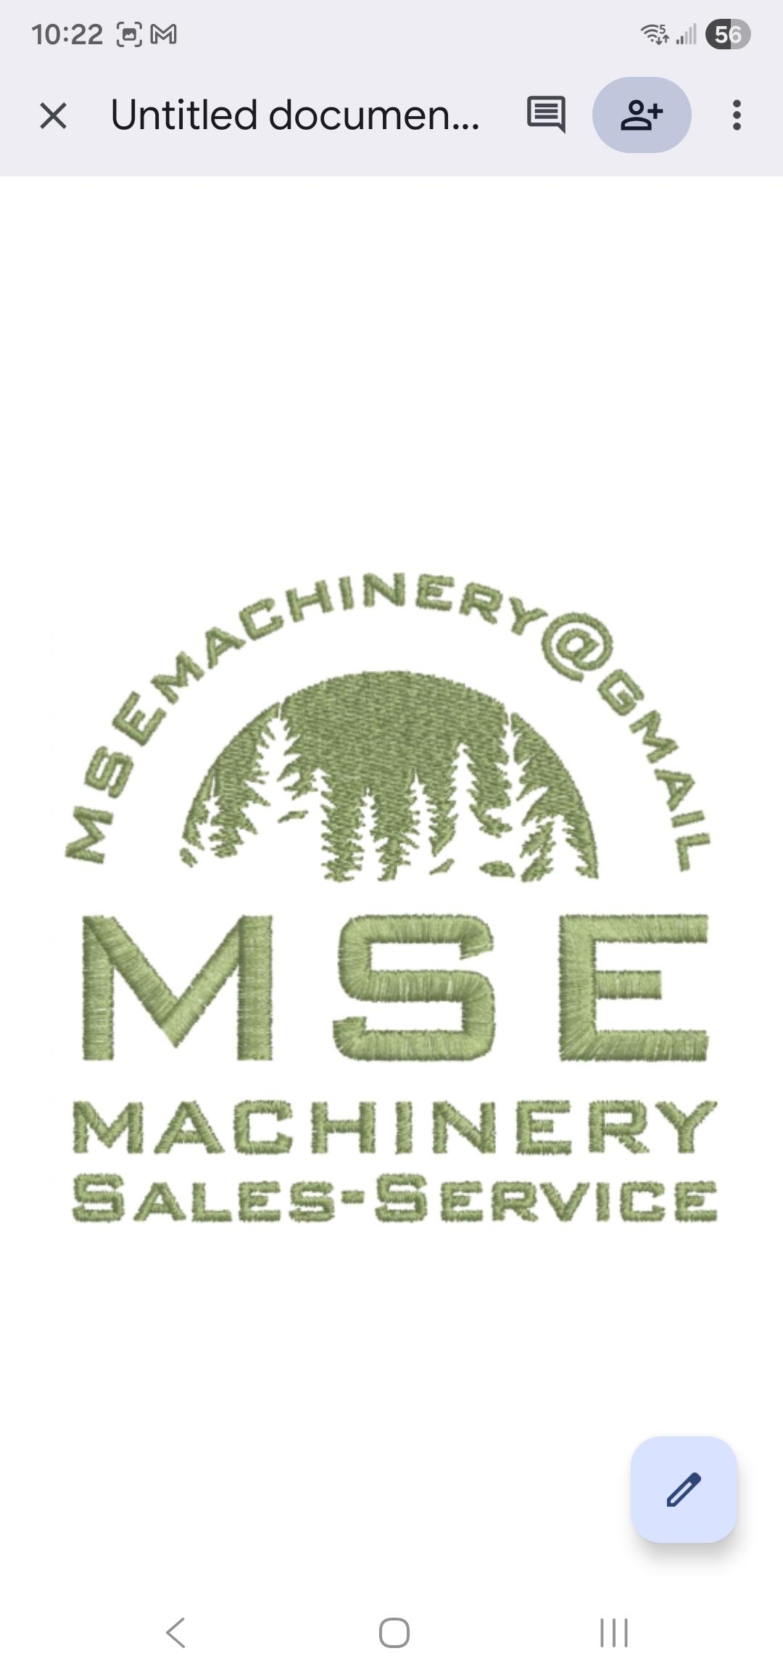
Why build a NEW dealership North of Toronto in Simcoe-Muskoka?
Buyers in Simcoe & Muskoka and most of North America are largely unwilling to take the extra risks of buying equipment from overseas. They worry that support and warranty and of course quality will disappear as soon as it arrives on Canadian soil. This is where I can help.
I'm looking for a long term business partner who will allow me to source from them so I can sell & service small to medium sized CONSTRUCTION & FARM Equipment in the 15 to 150HP range at very competitive prices. Simcoe & Muskoka are growing and desperately need affordable but also good quality farm, construction, mining and forestry equipment with service and support that's within Simcoe & Muskoka and Canada. There's lots of opportunity north of Toronto!
MSE can offer value to LS Tractors as a NEW dealership!

Slide 5
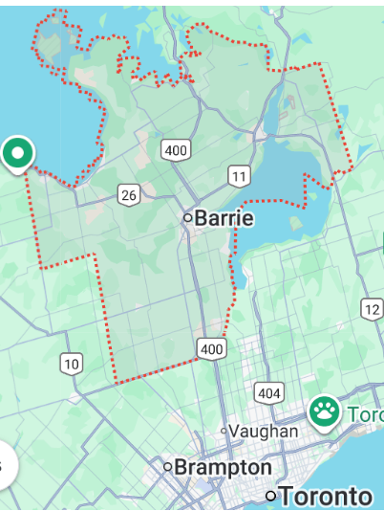
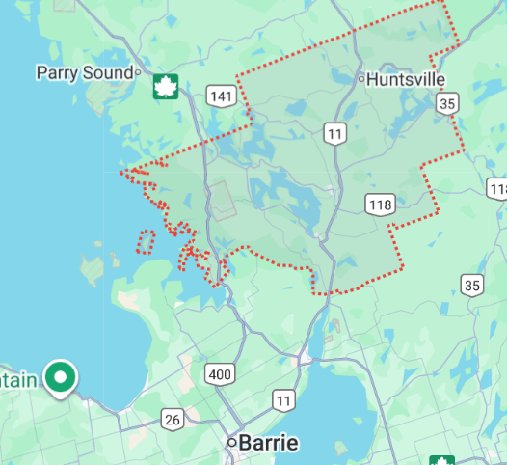
Where is SIMCOE , MUSKOKA in relation to TORONTO?
Simcoe - Muskoka are two separate Municipalities located near TORONTO, Ontario, CANADA
A municipality is a Large area that often contains lakes, forests, Villages, Towns and whole Cities like Barrie.
The golden triangle , mentioned before, has the 3 cities that make the 3 corners of the Golden triangle.
New Dealership
New Dealership
Municipality of SIMCOE
Municipality of MUSKOKA

Slide 6
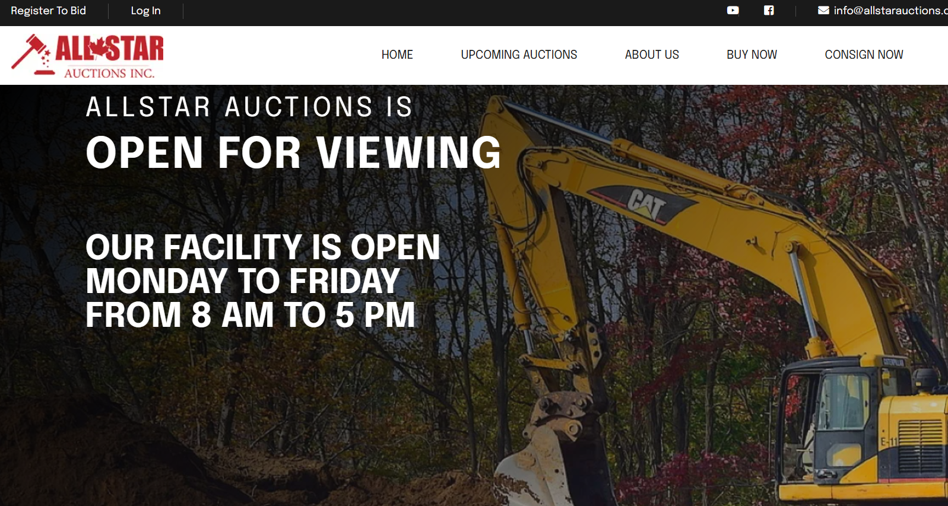
What BENEFITS can I offer LS Tractors Tractors?
The benefits of a “LS Tractors" dealership in Simcoe-Muskoka ....
Benefit #1. Start small. Then build on KNOWN sales successes by building clientele confidence with consistent, good service and support. Your company’s AGRICULTURE product lines fits perfectly with clientele demand in my geographic location.
Benefit #2. My business is located within 45 min of Canada's largest city, Toronto & the GTA, which has the largest construction industry in all of Canada. There is a large international airport and shipping Port, Port of Toronto located only 90 minutes away from me.
Benefit #3. My business is minutes away (Line 9N & Hwy11) from one of Canada's largest heavy equipment auction houses (AllStar Auctions) that gives access to online and in-person sales across Canada.
Benefit #4 My dealership Location is ideal because it is located in Simcoe-Muskoka which has strong agriculture and construction equipment demand and cottage country weekend warriors who need good equipment.
Benefit #5 . I'm located close to the LS tractor’s distribution center in Alliston (within 45 min) allowing easier delivery to customers . This can possibly allow a coordinated (Dealer/customer/distribution center) direct delivery creating further savings in the LS supply chain that can make LS more competitive against Kioti and others in Simcoe-Muskoka

Slide 7

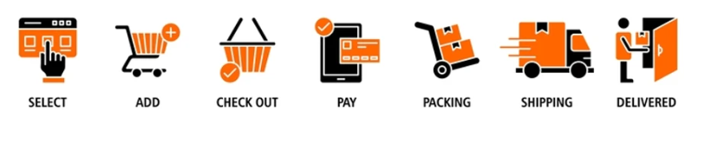
A Customized online website that customers can see the PRICE $ and create online orders, pay the deposit and then take delivery.
Check out our website for LOVOL tractors and SKOTT EACHAN group at
www.MapleSpringsEnergy.ca
MSE Website to be Modeled after LS Tractors website or as required by LS Tractors
To keep costs down and allow the dealership to grow as demand increases, an online presence is paramount.
Much like many car dealership business models, I wish to have a few demonstration models at the dealership for trial etc. The customer then orders their specific unit . This saves capital carrying charges by not having inventory sitting on the lot being exposed to weather, time and depreciation.

Slide 8
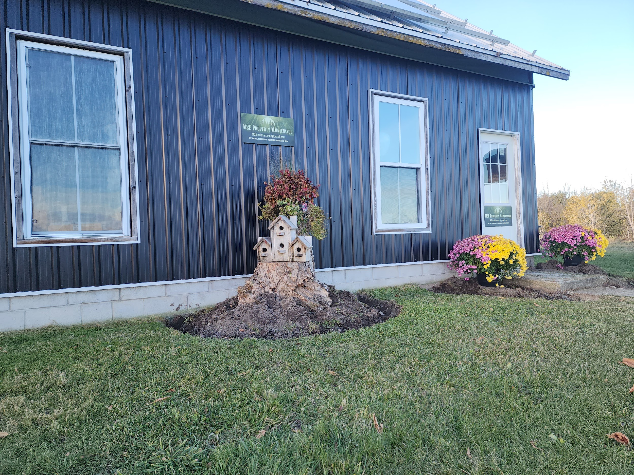
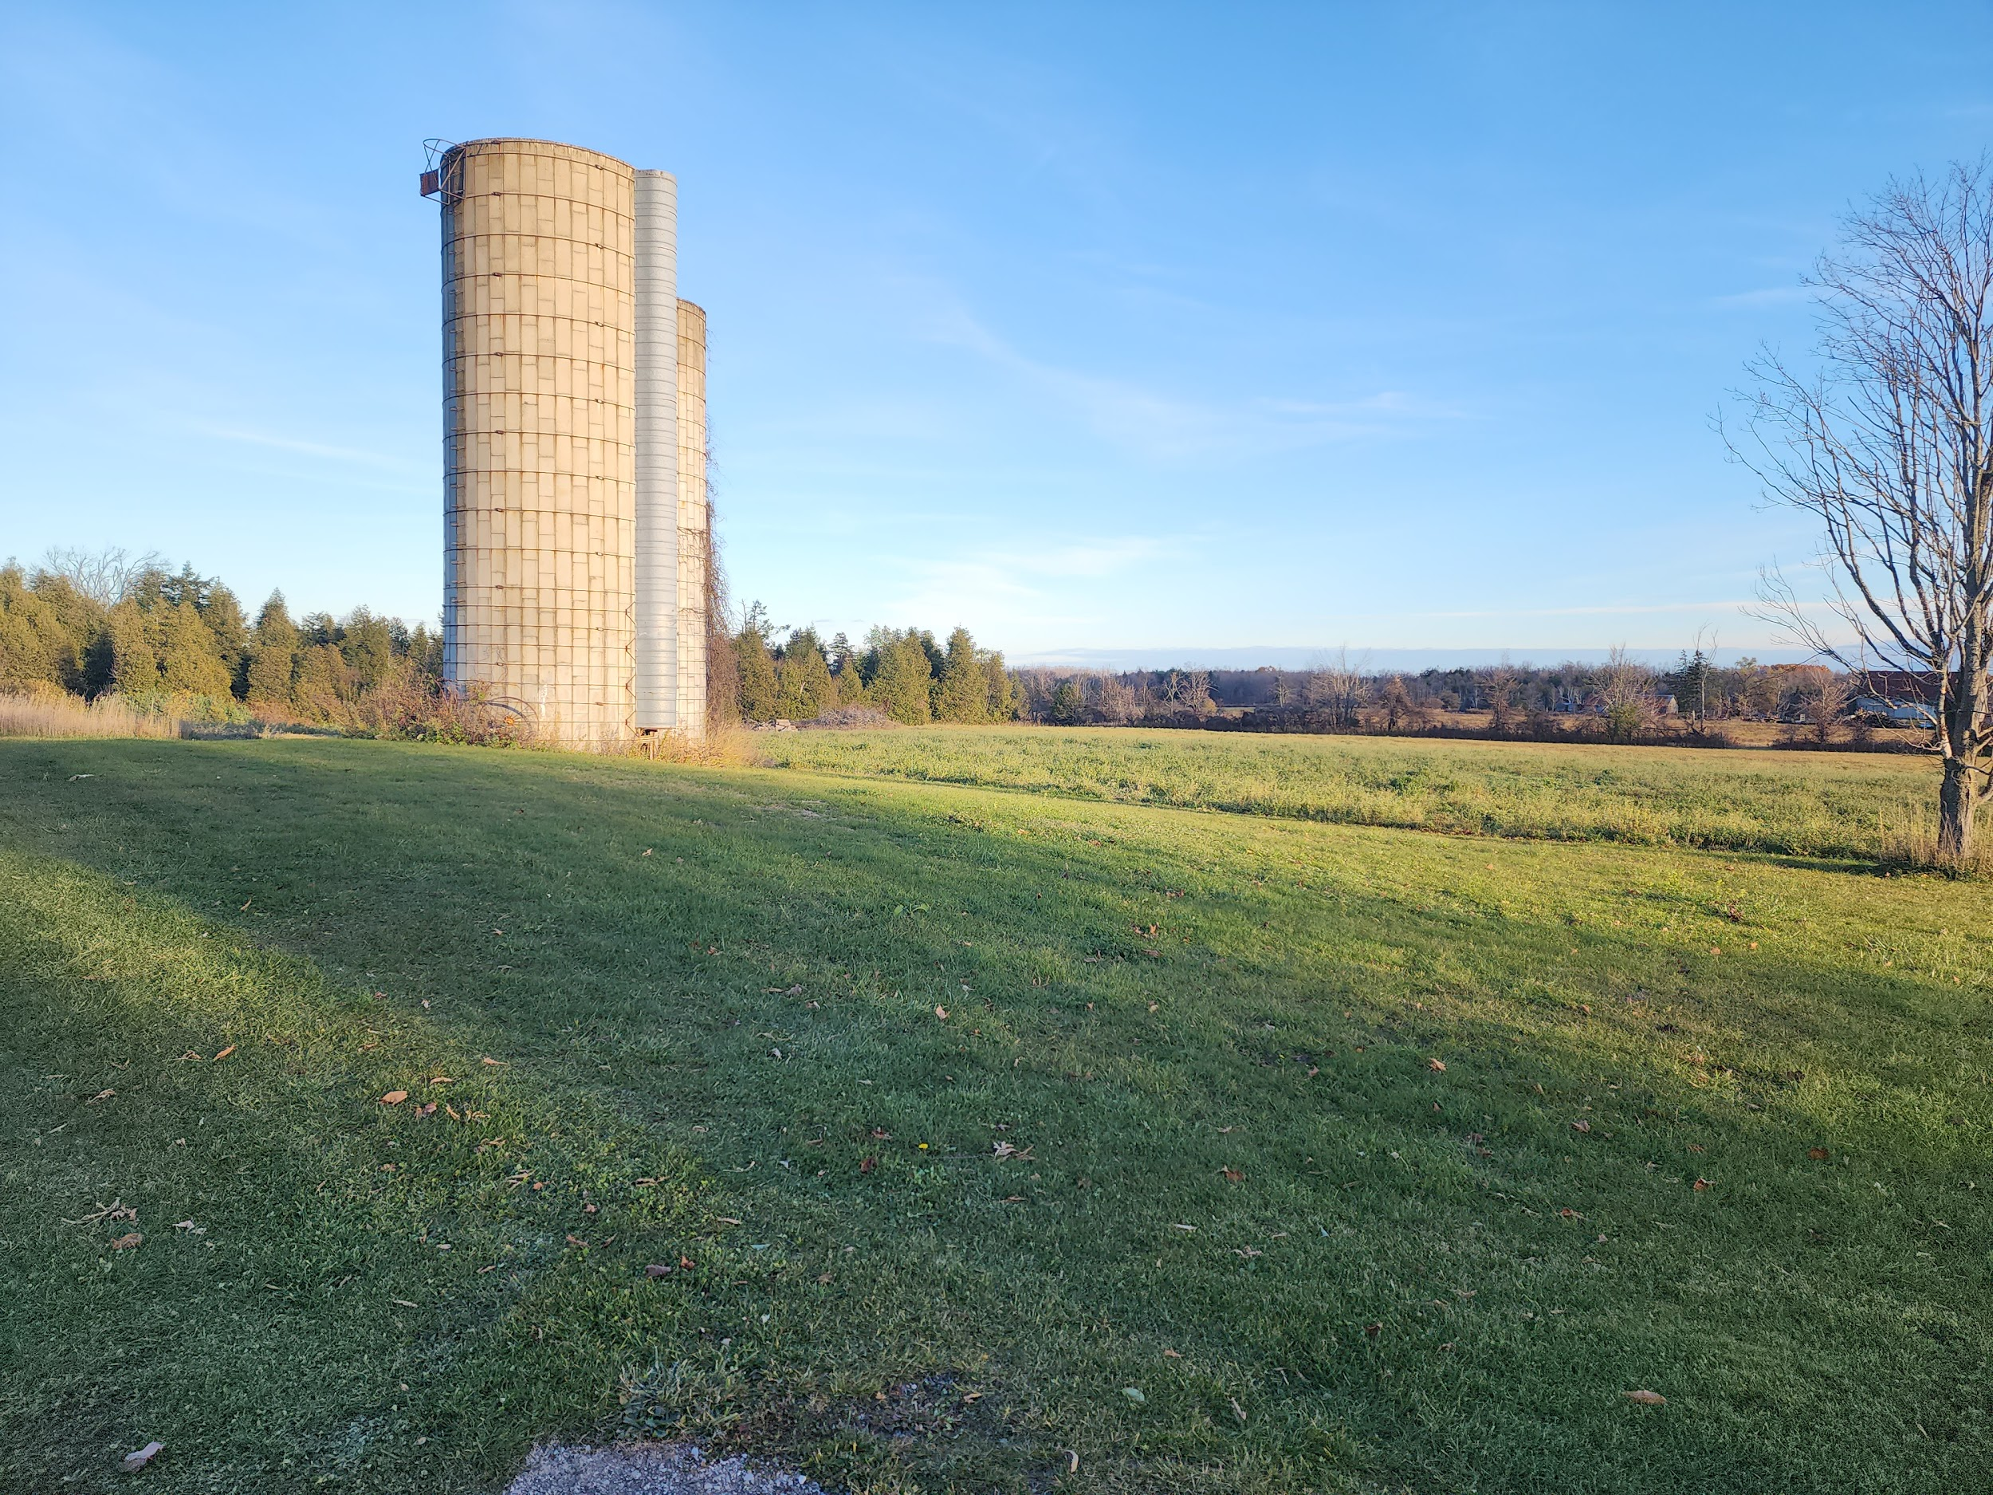
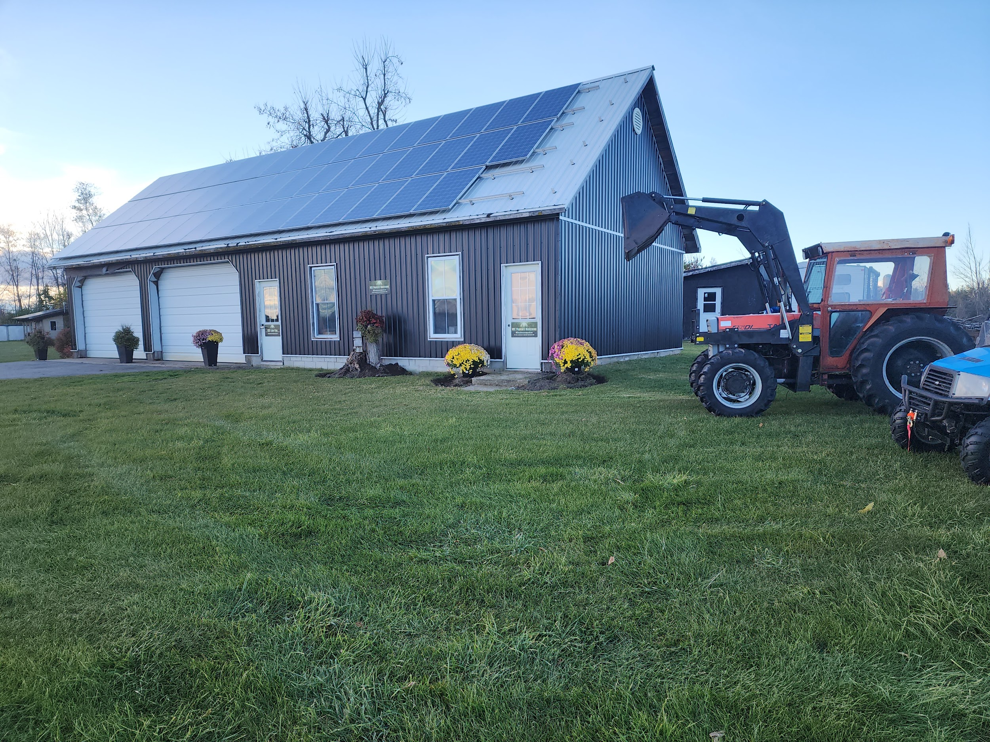
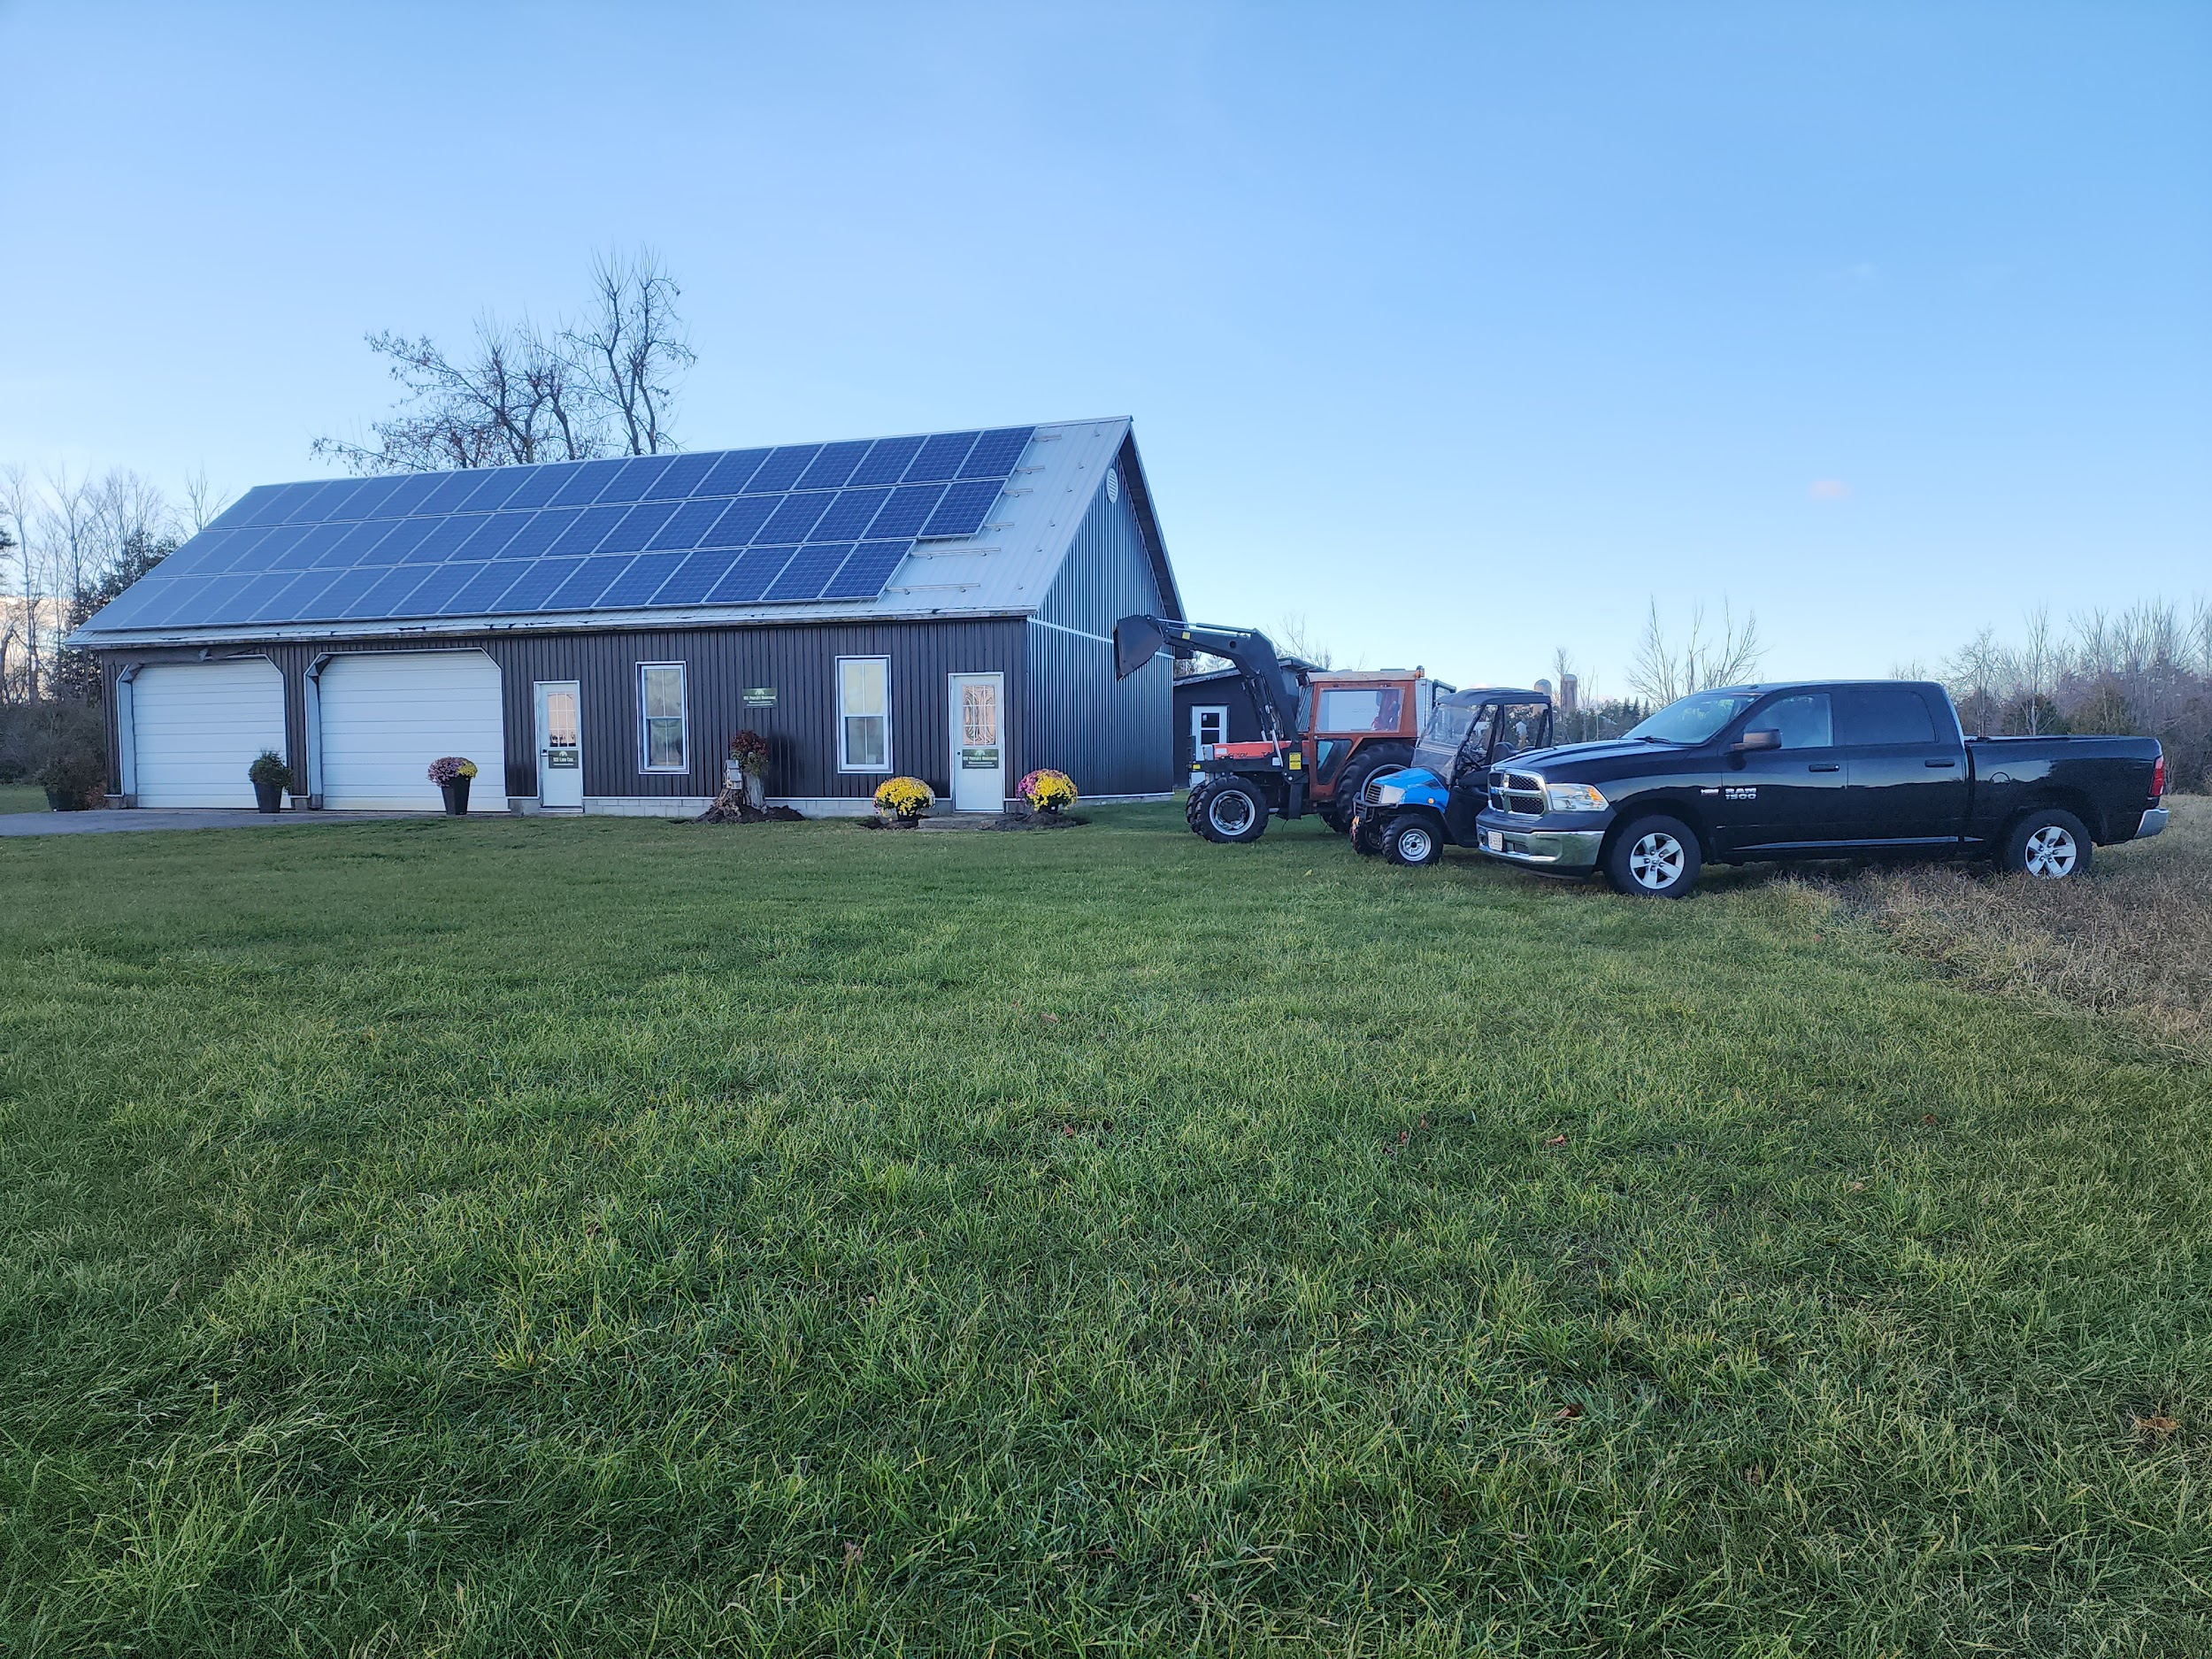
A New Boutique style Farm Machinery Dealership in Oro-Medonte
Definition of Boutique? a business or establishment that is small and sophisticated or fashionable.
Simcoe Muskoka

Slide 9
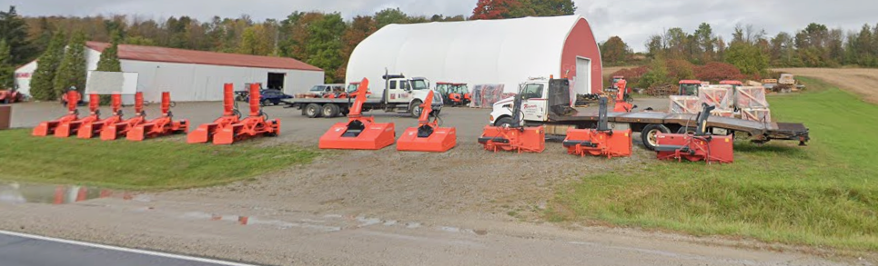
Boutique style Farm Machinery Dealership v.s. Industrial Dealership
Boutique Dealership ? a business or establishment that is small and sophisticated or fashionable. Family friendly.
v.s. versus
Industrial Dealership ? An industrial business is one involved in the production, manufacturing, storage, or distribution of goods. Not family friendly.

Slide 10
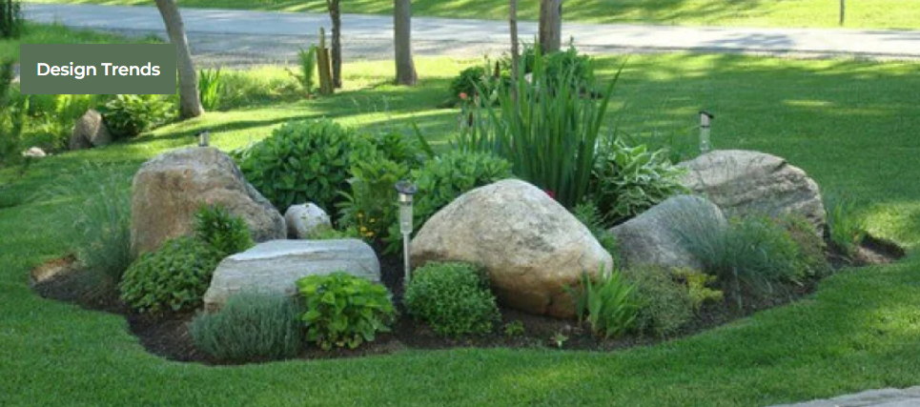
Simcoe Muskoka
The Perfect Match of Size and Power

Slide 11
It's a destination for the whole family & friends
to meet and pick out a major purchase like a tractor with a personal and welcoming farm experience.
Simcoe Muskoka

Slide 12
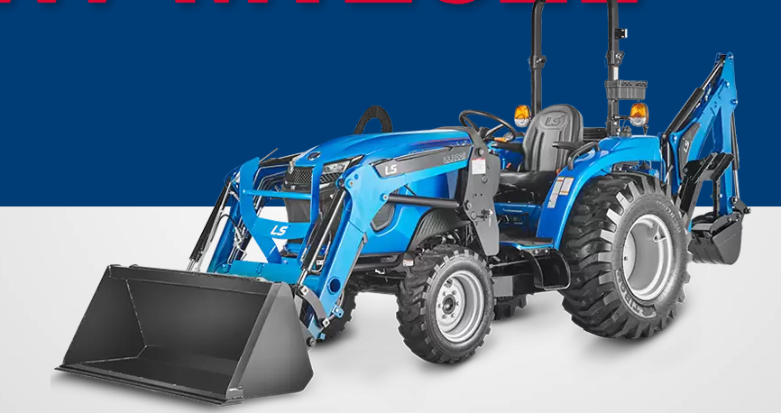
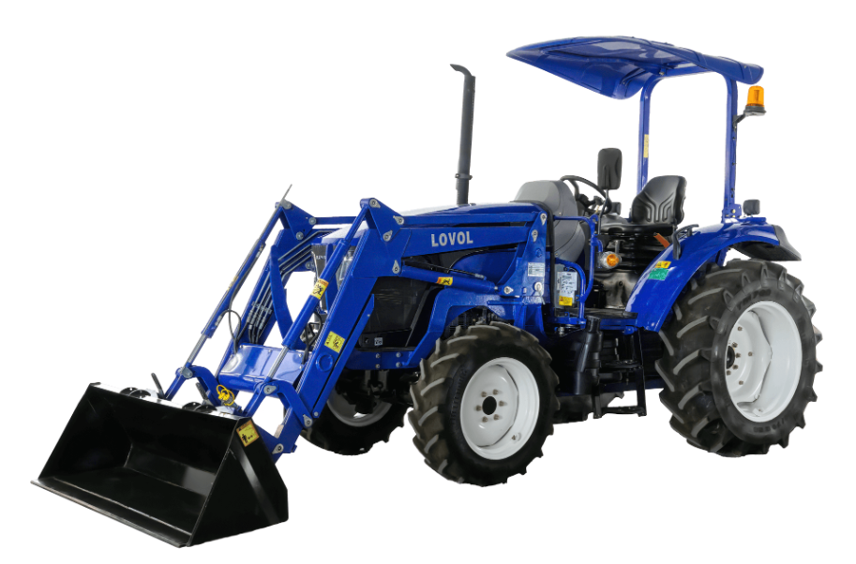
Live demonstrations of the tractors in the fields for visitors to try out the machine before buying it
Simcoe Muskoka
The Perfect Match of Size and Power

Slide 13
The building is already there and is a symbol of a traditional farm
It’s Boutique and family orientated
Simcoe Muskoka

Slide 14
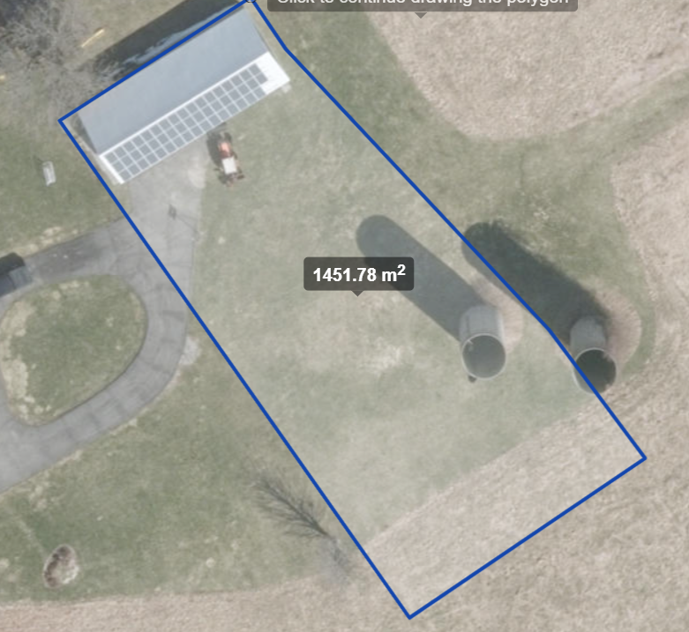
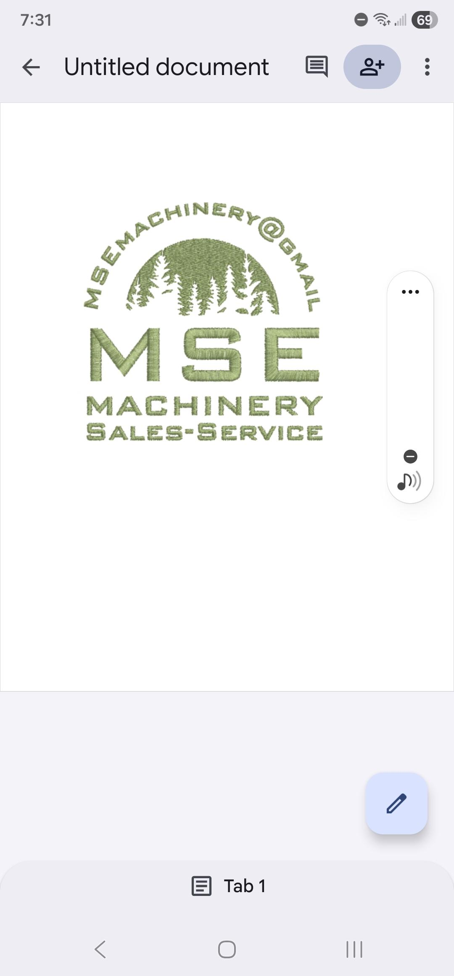
Site Plan - MSE Machinery CANADA
20m
Existing Showroom & Service areas
Silo = Advertising
60m
Future Site of New Showroom and storage building
Simcoe GIS 2024

Slide 15
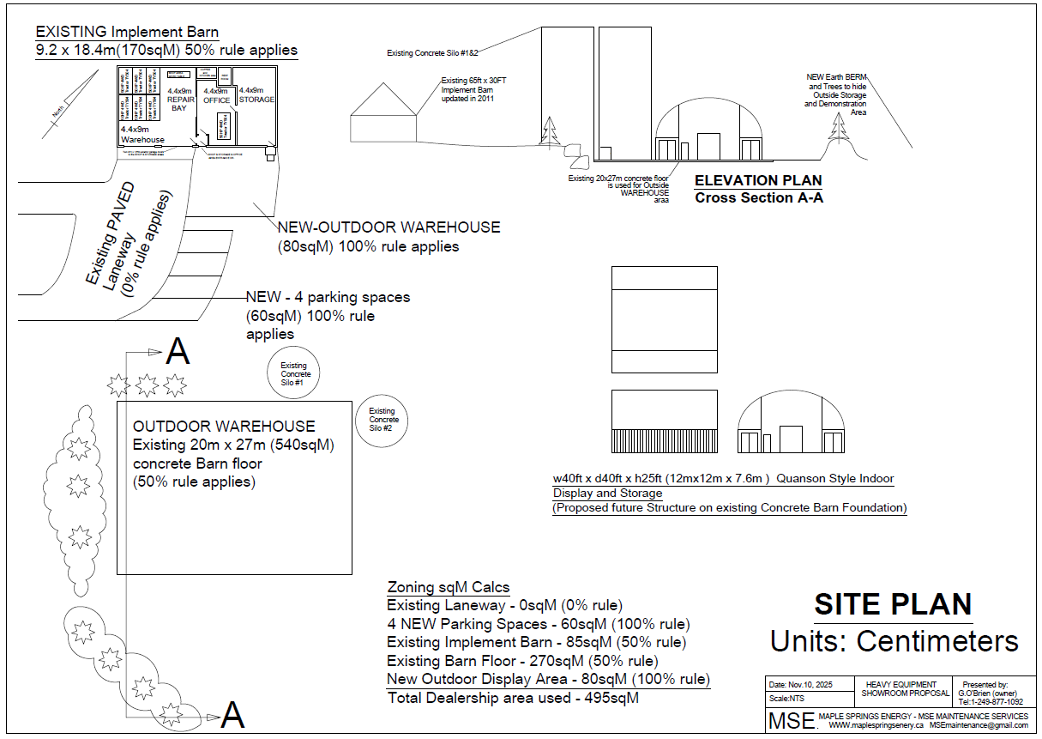
Site Plan - MSE Machinery CANADA

Slide 16
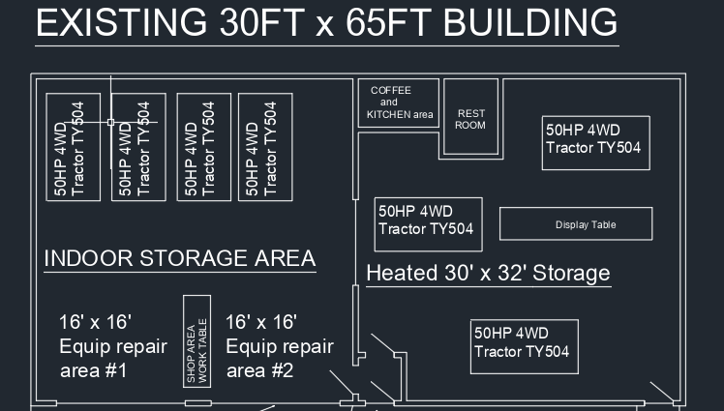
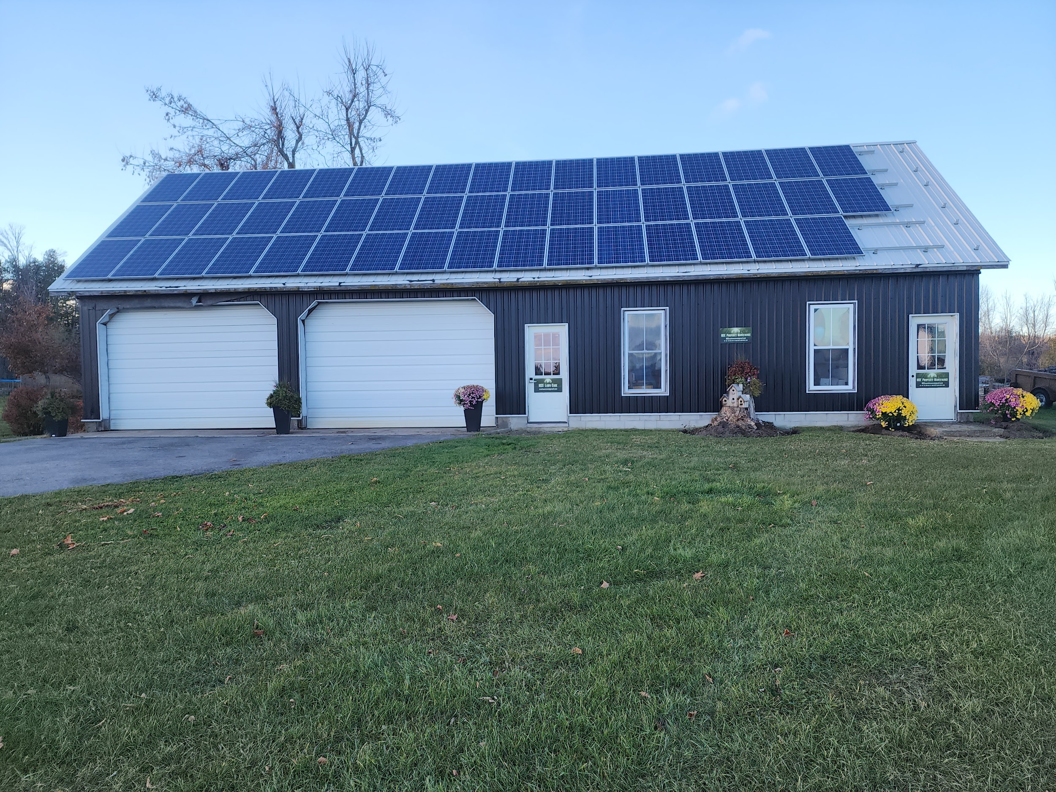
A look inside of the existing STORAGE & SHOWROOM

Slide 17
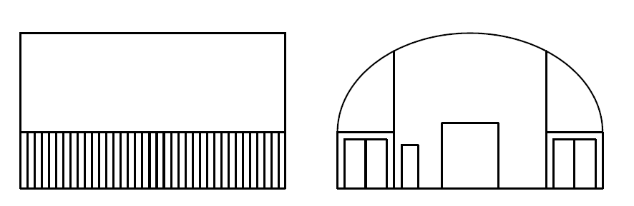
A 40ft x 40ft Quonset Building built on top of the existing concrete pad from original barn will be repurposed to service tractors and equipment outdoors
A earth BERM will be created on the West and South sides and will use materials from the barn location screening the area from sound and views from the road and surroundings neighbors.
Existing concrete protects the area from contaminated soaking into the ground and allows easy identification & cleanup
Propose Future 40ft x 40ft Indoor SERVICE area - MSE Machinery CANADA
LOTS OF ROOM TO GROW THE DEALERSHIP

Slide 18
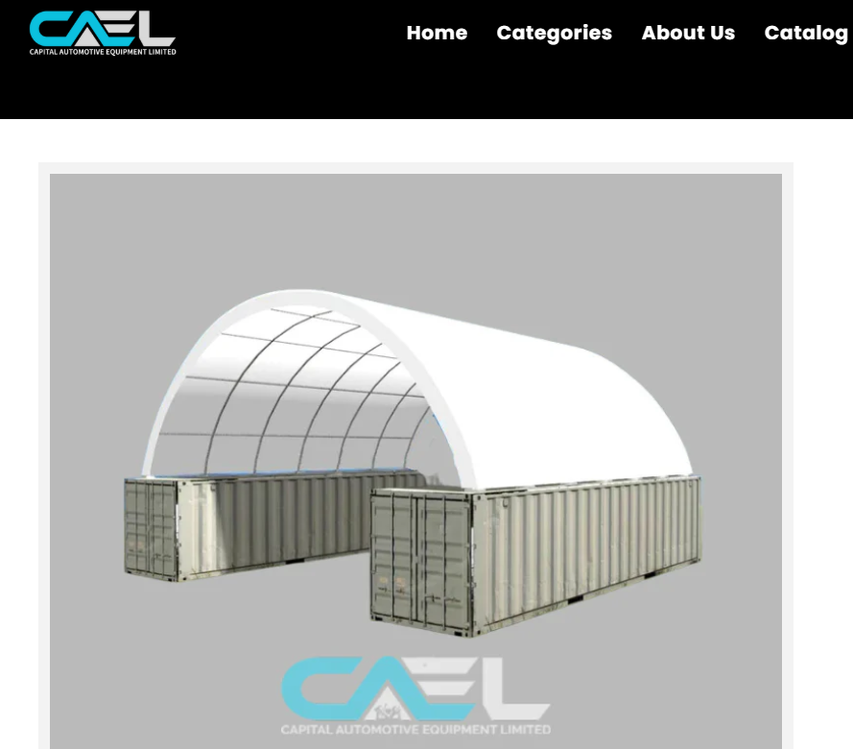
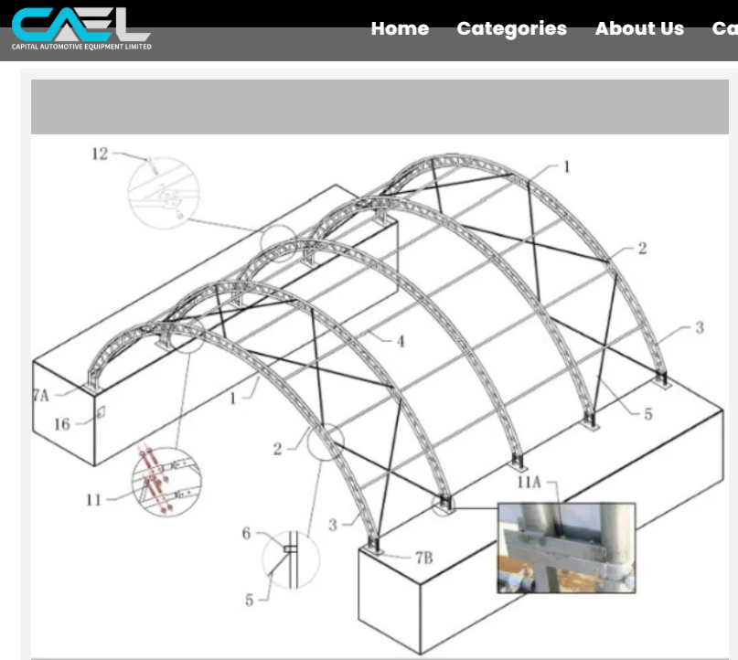
Propose Future 40ft x 40ft Indoor SERVICE area - MSE Machinery CANADA

Slide 19
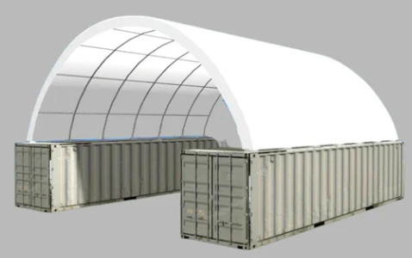
Future Expansion of Indoor storage and showroom
Simcoe Muskoka

Slide 20
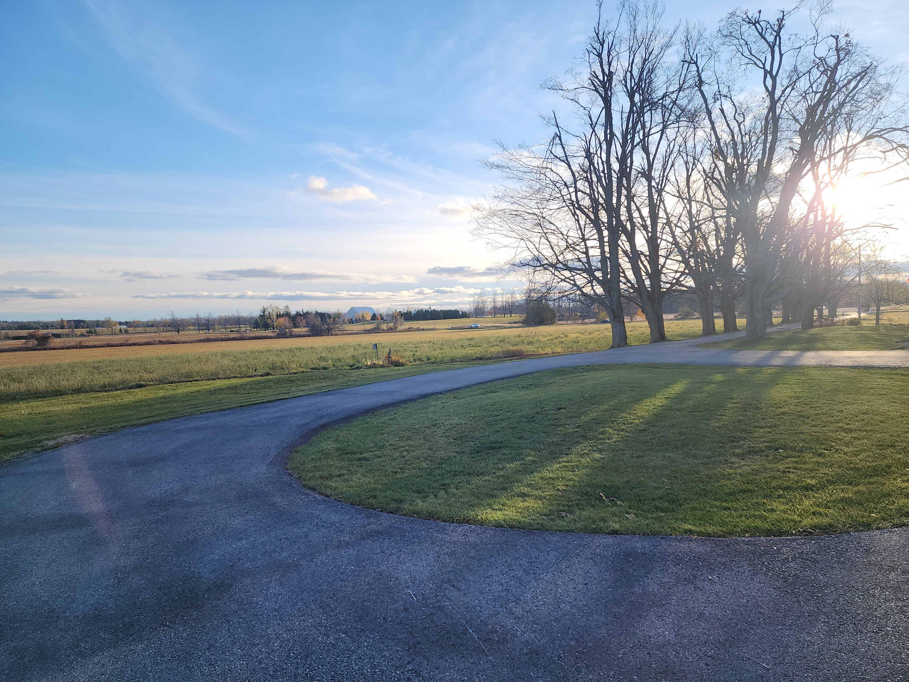
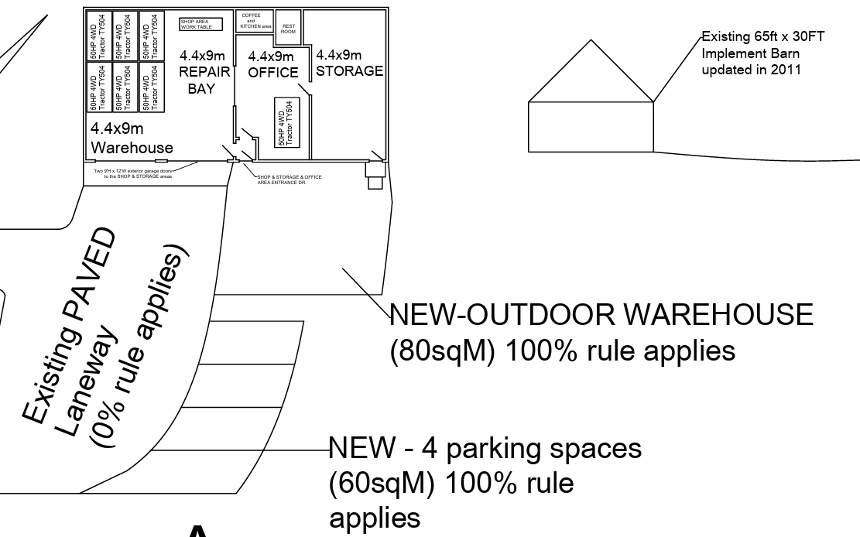
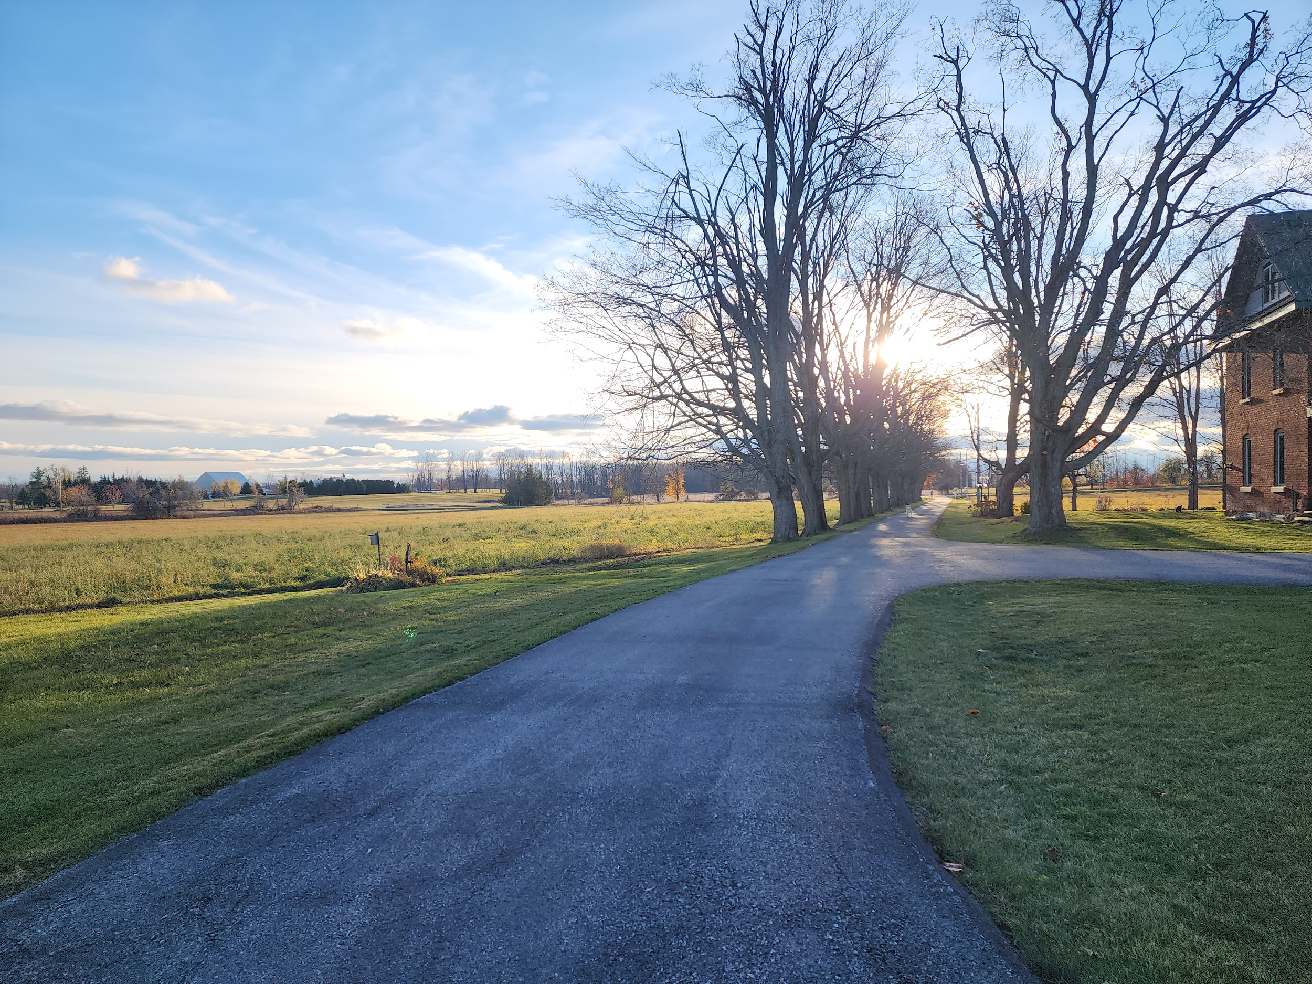
Beautiful, landscaped gardens to greet customers in friendly and welcoming countryside atmosphere.
Paved driveway and parking lot for 4 vehicles. Additional parking on Turn-around area.
New concrete stone sidewalk added to access the indoor heated and cold storage areas and indoor service areas
2 tractors will be parked in the outdoor space to display equipment in summer time. Equipment moved inside to showroom for remaining wet and winter seasons.
EXISTING Outdoor Parking area - MSE Machinery CANADA

Slide 21
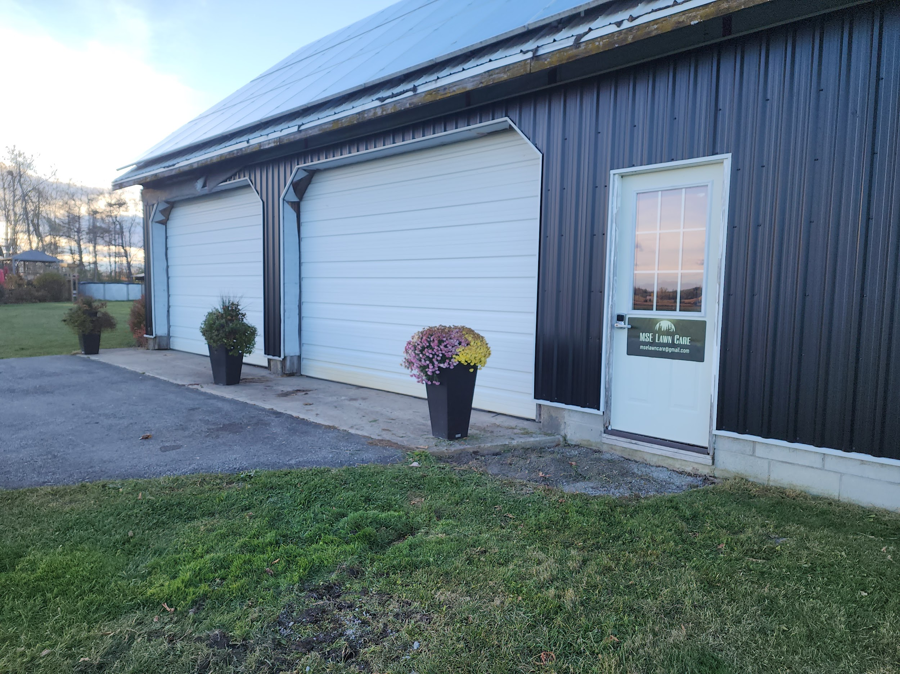
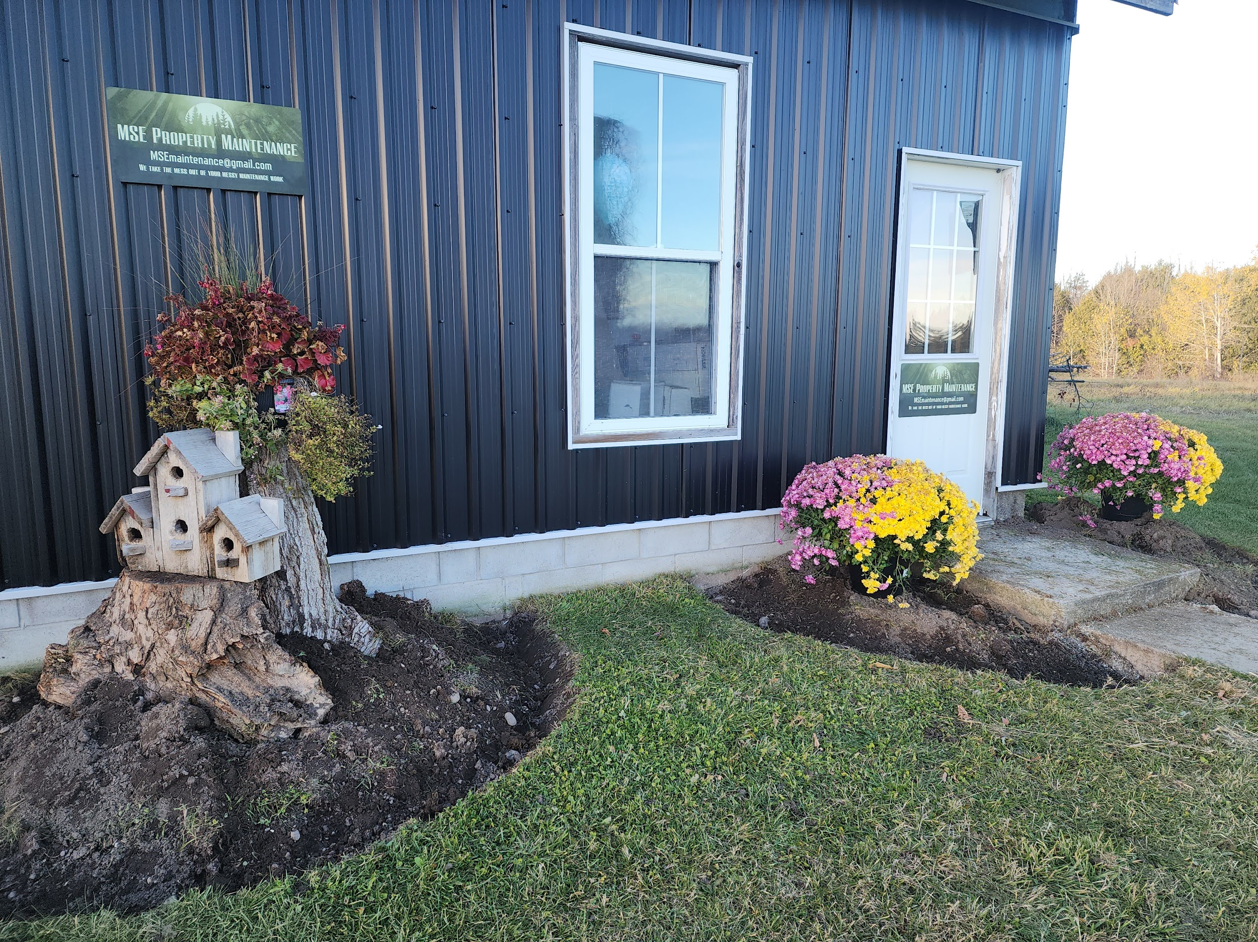
Which Entrance or area is the MOST important one? ……………………………………………
Outdoor Showroom AREA
Paved Parking Lot
MOST IMPORTANT is…..
Shop & Service Entrance
Customer Entrance

Slide 22
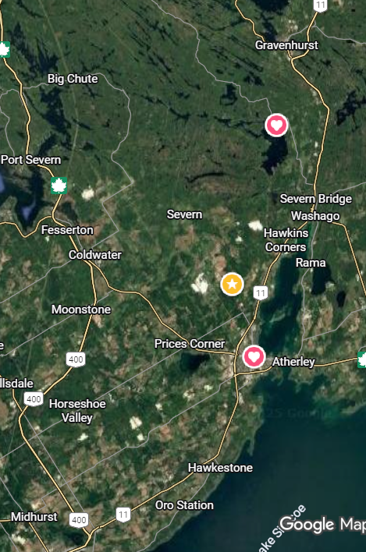
The Competition and their prices
70hp tractor c/w cab & loader.
- Target sell price is $40K
Kubota North 51hp $??K with cab & loader
BIGGEST COMPETITOR
Beard’s Equipment KIOTI 47hp $52K with cab & loader
Byers John Deere 51hp $??K with cab & loader
McCauley New Holland 55hp $75K with cab & loader
Richards Equipment
Mahindra 45hp $43K with loader but no CAB

Slide 23
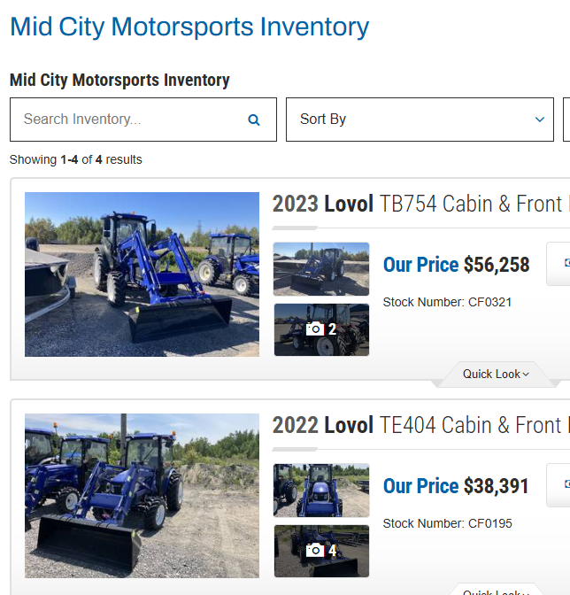
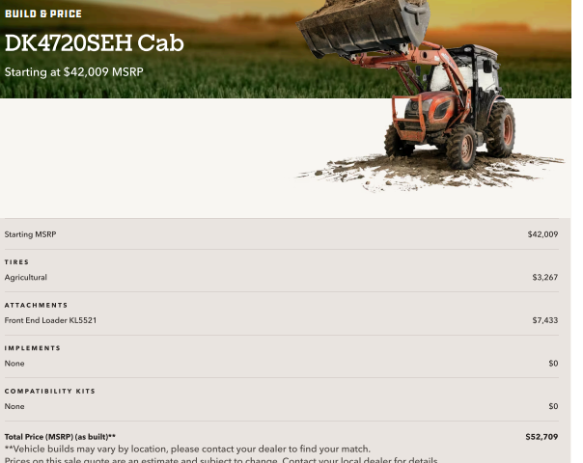
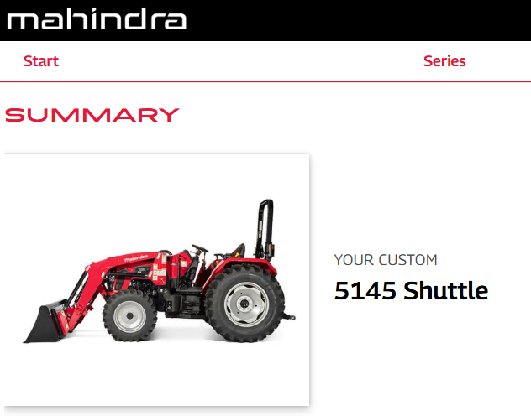
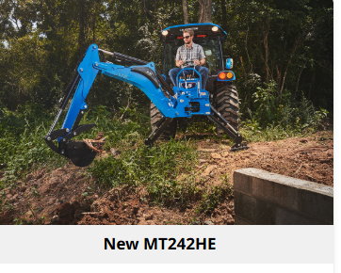
The Strongest $ Competition and their prices
Lovol 75HP $56K-cab & loader
Kioti 47HP $52K-cab & Loader
Mahindra 45HP $43K-loader & no cab
LS 42HP $52K-cab & loader

Slide 24
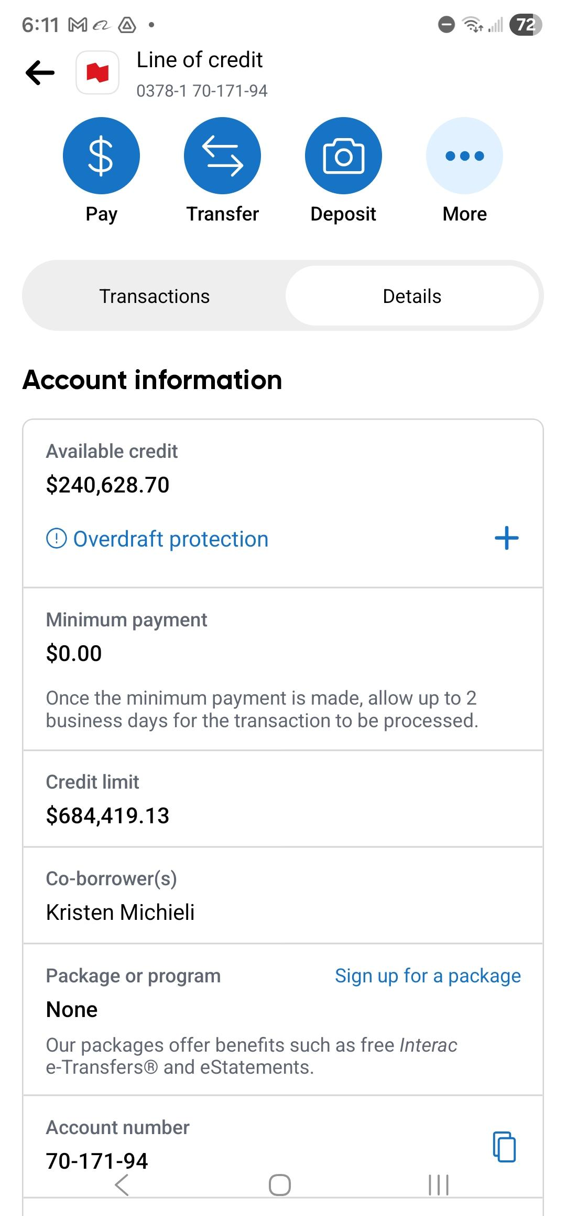
Wholesale Dealership Account with National Bank of Canada for over $684 K in total credit available and over 300K available immediately
$ =
=

Slide 25
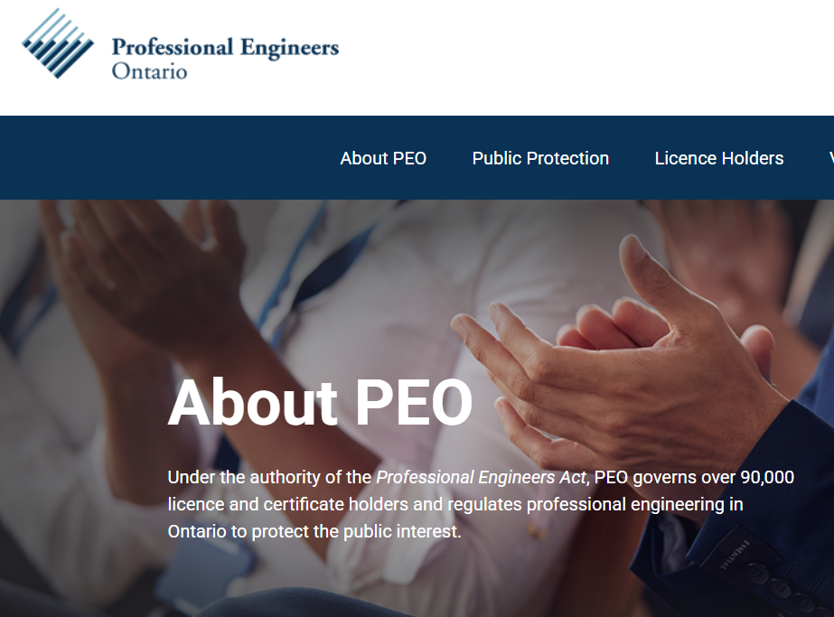
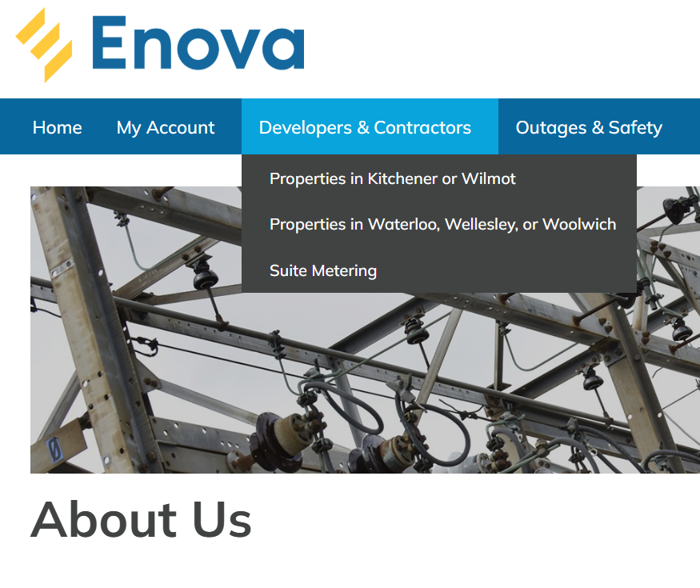
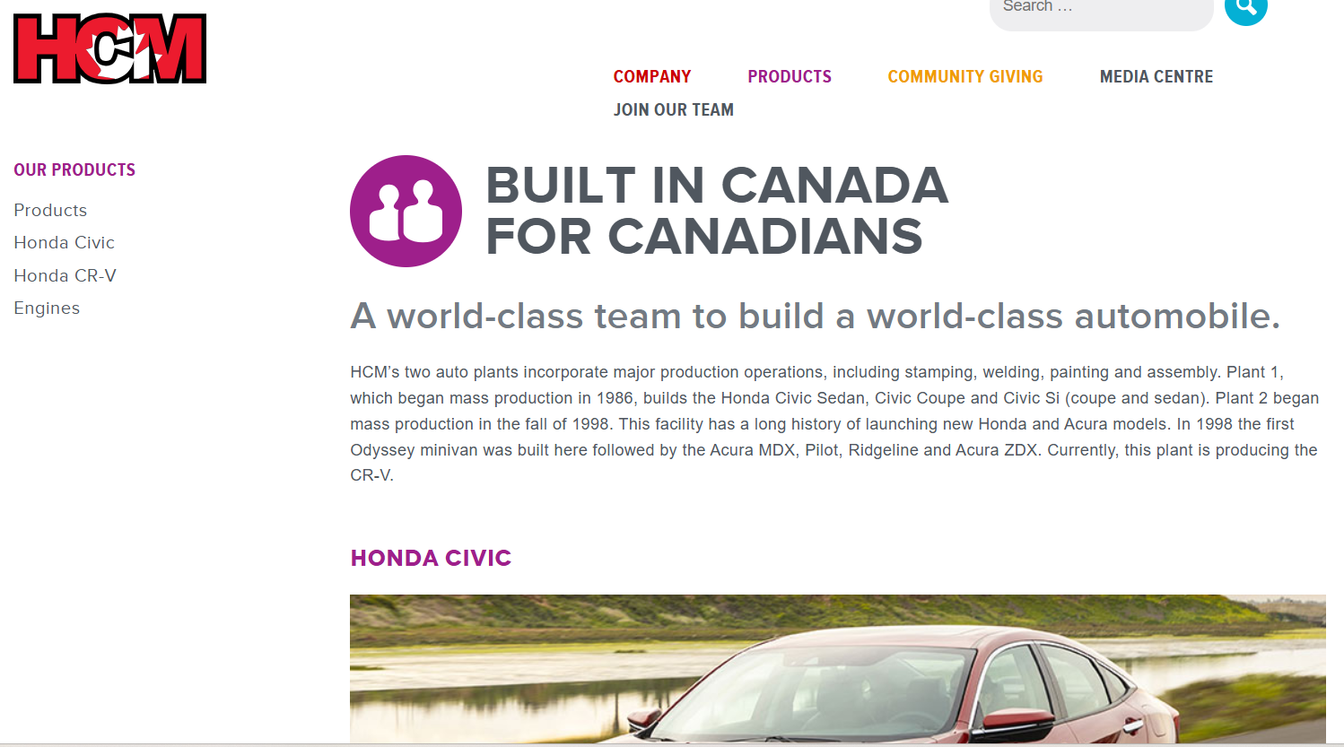
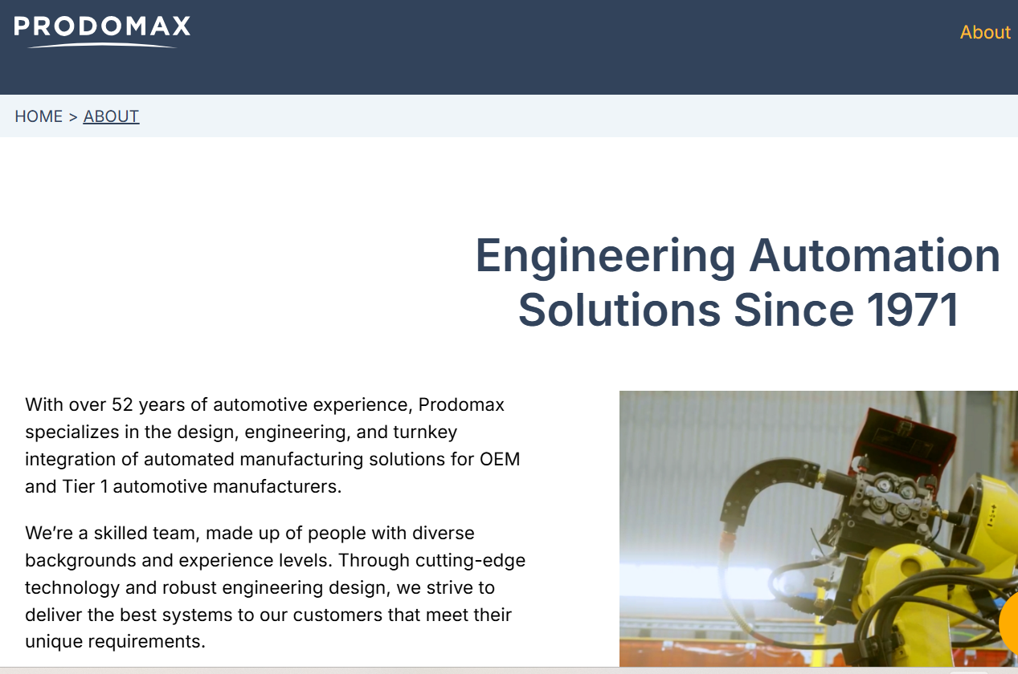
Who is Glen O’Brien, P.eng?
Who is Glen O’Brien?

Slide 26
Who is Glen O’Brien, P.eng?
My name is Glen O’Brien. I am 56 years young.
I am retired Engineer with over 35 years industry experience with a full pension and lots of time and resources on my hands.
I’ve own & operate a farm since 1998.
I own and Residential Retailing & constructio business since 2011.
I am a Licensed Professional Engineer (P.eng) since 2000 and hold an Electrical Engineering degree with multiple specialized certificates in controls, power, hydraulics, pneumatics, programming, welding and mechanical design.
I wish to see POSITIVE CHANGE IN THE AFFORDABILITY of farm machines in our local area. I did this because I can’t find affordable equipment anywhere in Canada
I have over 35 years experience in the Engineering, maintenance, Automation, Power Energy and Agricultural and sales.
I have worked for fortune 500 companies in roles involving Design, Maintenance, Engineering, Sales and Project management.
I oversaw multi-million dollar projects for Honda of Canada Mfg, Magna International group of companies and Prodomax Automation.
I have heavy equipment and farm equipment experience as an Operator, as a Mechanic and as an Engineer.

Slide 27
Thank you for your consideration of becoming a Dealership for LS Tractors .
Contact information
Glen O’Brien, P.Eng
Tel: 249-877-1092
Whats APP & SMS: 1-249-877-1092
E1: MSEmachinery@gmail.com
www.MapleSpringsEnergy.ca
Simcoe Muskoka
The Perfect Match of Size and Power

